Slide 1


Logistics Analysis: Performance, Cost & Partner Evaluation
Done by :
Fatima Ali - Mariam Azam -
Zahra Alrosani - Ayat Mohammed
Group #1

Slide 2


About Olist
Founded in 2015, Olist is a Brazilian e-commerce platform that empowers businesses of all sizes to succeed in digital commerce by simplifying access to marketplaces and logistics solutions.
The client , a growing e-commerce platform , requested a comprehensive logistics performance analysis to evaluate the efficiency of its current delivery partner. The goal is to identify key factors impacting delivery delays, shipping costs, and fulfillment times, to support renewal decisions and optimize logistics operations statement.
Problem & Goal

Slide 3

Logistic Performance Overview
Total Number of Delivered
Orders
Late Delivery Orders
Total Number of Orders
98.67 K
96.48 K
6535
Early Delivery Orders
On Time Delivery Orders
Average Days to Deliver Order
88.61 K
1292
12.41

Slide 4
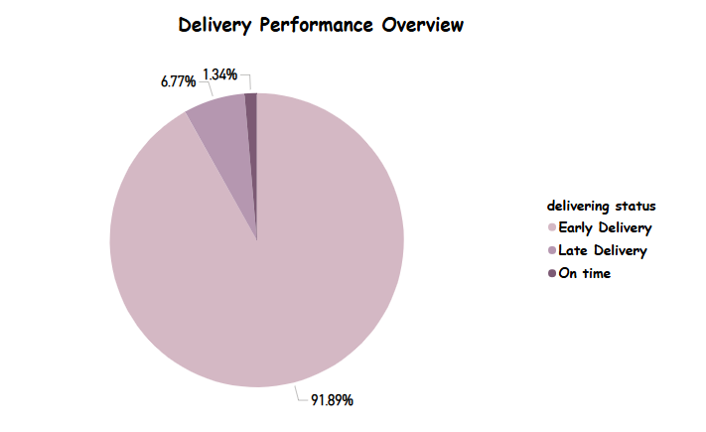

Delivery Timeliness Overview

Slide 5
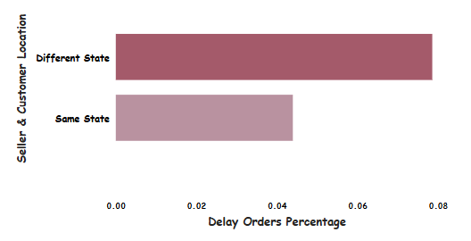
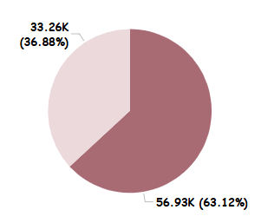
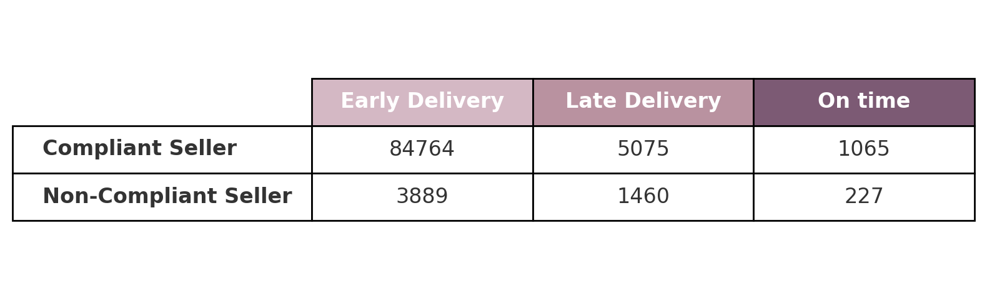
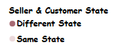
Impact of Seller-Customer Location on Delivery Performance

Slide 6
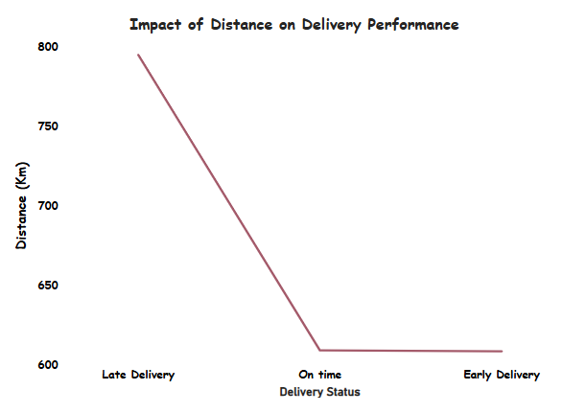
How Distance Influences Delivery Performance

Slide 7
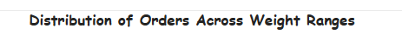
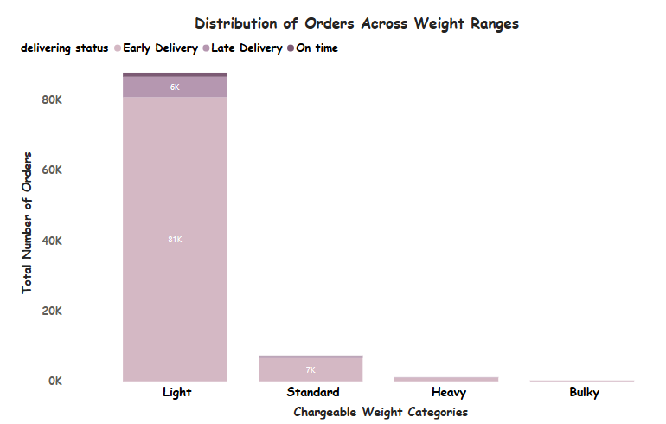
Distribution of Orders Across Weight Ranges

Slide 8
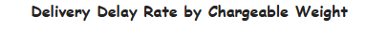
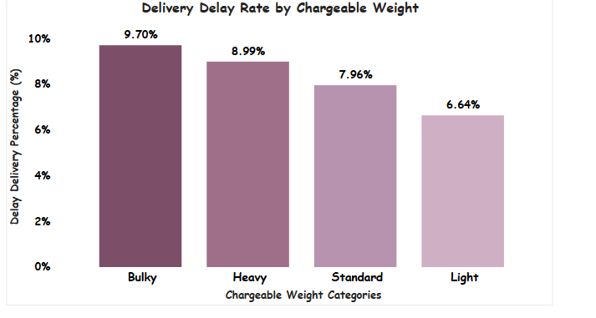
How Delay Rate Vary by Chargeable Weights

Slide 9
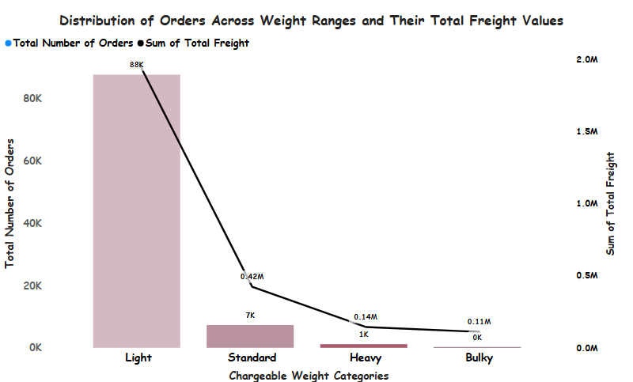
Relationship of Shipping Cost with Chargeable Weights

Slide 10
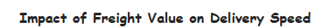
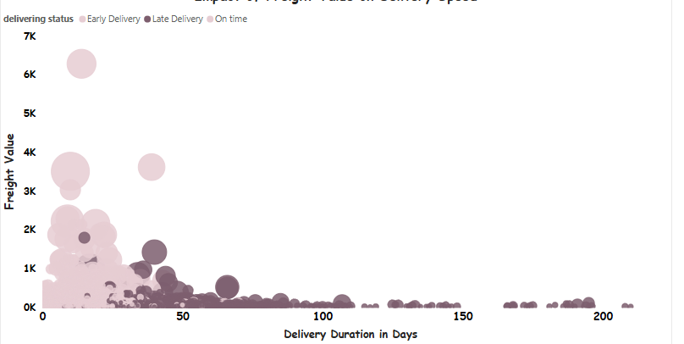
Impact of Shipping Cost on Delivery Speed
Size of bubbles: Average of Chargeable Weight

Slide 11
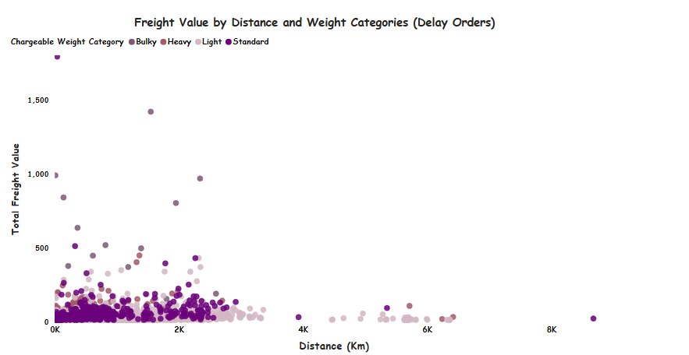
Effect of Distance on Freight Charges (Late Deliveries)

Slide 12
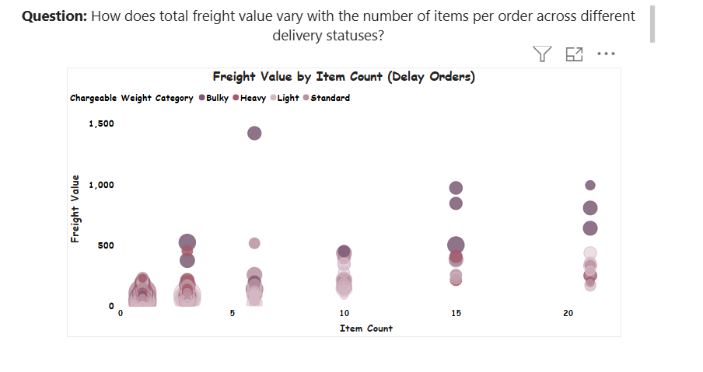
Impact of Order Size and Weight on Freight Cost
Size of bubbles: Average of delivery duration

Slide 13
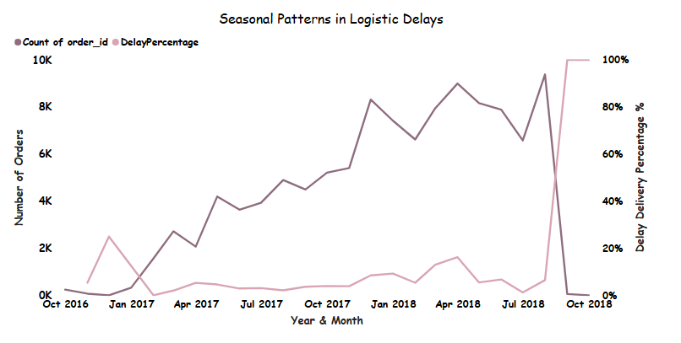
Seasonal Patterns in Logistic Delays

Slide 14
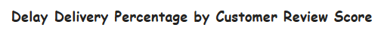

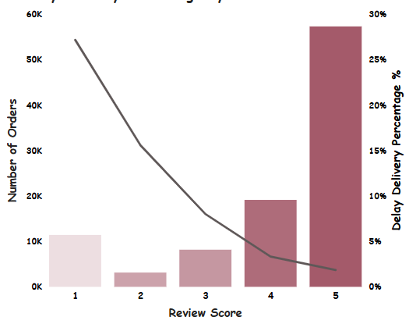
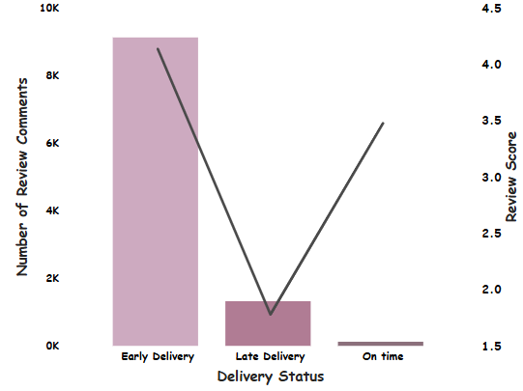
Customer Feedback Based on Delivery Performance

Slide 15



Limitations
Lack of information regarding the Mode of Transportation
(e.g., air, land, or sea)
This affects the interpretation of delivery times and logistics performance.
Unclear Delay Reasons
The logistics provider did not share specific reasons for late deliveries, making it difficult to identify root causes.
Incomplete Timeline
2016: Only includes November–December data
2018: Only includes data until October.

Slide 16
Recommendations
Take a strategic phased approach for partnership with the Logistic company
Negotiate a revised SLA-based contract with the current partner that links pricing to delivery performance.
Define features clearly (shipping methods, cost per kg, reasons for delay etc.) to monitor logistics performance moving forward.

Slide 17
Thank You

